Slide 1
Group Two Task: Unit one Reading Skills
第2组：第一单元的阅读技巧
Part 1:
Part 2 and 3:
Part 4:
Part 5 and Summary:
陈俊峰
庞子良
谢宏伟
刘鹏

Slide 2
C
ONTENTS
1
Chronological sequence
2
Cause & Effect
3
Comparison & Contrast
4
Classification
5
Problem & Solution

Slide 3
Part I: Chronological sequence
第1部分：时间顺序

Slide 4
What are the reading skills?
Introduction
Reading skills enable readers to turn writing into meaning and achieve the goals of independence, comprehension, and fluency.
Definition
·to read the written form as meaningful language
·To read anything written with independence, comprehension and fluency
·To mentally interact with the message.

Slide 5
Predicting Theme and Identifying Patterns and Structures
A piece of writing for general purposes is composed of:
A title
An introduction
echo
The theme
A body
A conclusion
Firstly

Slide 6
Predicting Theme and Identifying Patterns and Structures
For research that
involves reading a huge number of academic papers:
We will face the problems
Good or bad
Useful or useless
Certified or uncertified
New or outdate
So we should optimise our reading strategy
Secondly

Slide 7
How can I improve my reading skills?
1
A quick scan
A quick scan of the paper’s title,the abstract,the introduction
and the conclusion
While skipping the body,would present a general idea of the paper
Finally

Slide 8
How can I improve my reading skills?
2
To identify the theme or the main ideas
Sometimes shed light upon important details
Whether the paper benefits their research
Whether it is necessary to go on reading the rest or not
Finally

Slide 9
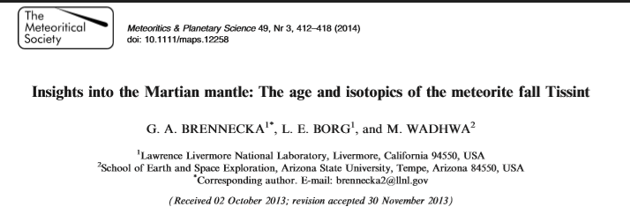
In conclusion，how and when to use reading skills?
For example:I want to figure out a age of Tissint
Scan this title

Slide 10
In conclusion，how and when to use reading skills?
For example:I want to figure out a age of Tissint
The recent witnessed fall of the meteorite Tissint represents the delivery of a pristine new sample from the surface of Mars. This meteorite provides an unprecedented opportunity to study a variety of aspects about the planet’s evolution. Using the Rb–Sr and Sm–Nd isotopic systems, we determined that Tissint, a depleted shergottite, has a crystallization age of 574 ±20 Ma, an initial e143Nd =+42.2±0.5, and an initial 87Sr/86Sr = 0.700760 11. These initial Nd and Sr isotopic compositions suggest that Tissint originated from a mantle source on Mars that is distinct from the source reservoirs of the other Martian meteorites. The known crystallization ages, geochemical characteristics, ejection ages, and ejection dynamics of Tissint and other similarly grouped Martian meteorites suggest that they are likely derived from a source crater up to approximately 90 km in diameter with an age of approximately 1 Ma that is located on terrain that is approximately 600 million years old.
Scan this abstrcat
So it is worth to go on reading the rest

Slide 11
Chronological sequence
Authors can proceed with their writing in the order of time. Look for time markers at the start of a sentence while perusing the text. Longer time markers, usually in the form of adverbial clause, tend to be placed toward the end to avoid a top-heavy sentence structure. For instance
The Chinese economy has soard since the introduction of the Epoch-making policy of reform and opening-up in 1978 .
Weird
If put adverbial clause toward to start?
After the introduction of the Epoch-making policy of reform and opening-up in 1978 , the Chinese economy has soard .

Slide 12
Chronological sequence
With those time markers, we can understand the chronological order of the Article better. For example
Research spanning many decades has shown nutrients in the gastrointestinal tract can shape animals’flavour preferences./One of the earliest findings of this effect dates back to the 1960s,when Garvin Holman of the University of Washington reported hungry rats preferred consuming a liquid paired with food injected into the stomach rather than a solution coupled with a gastric infusion of water./More recently Ivan de Araujo,a neuroscientist at the Icahn School of Mdicine at Mount Sinai,and his colleagues have shown calories can trump palatability:Their work has demonstrated mice prefer consuming bitter solutions paired with a sugar infusion injected in the gut rather than a calorie-free sweet solution.

Slide 13
Part II: Cause and Effect
第2部分：原因
与影响

Slide 14
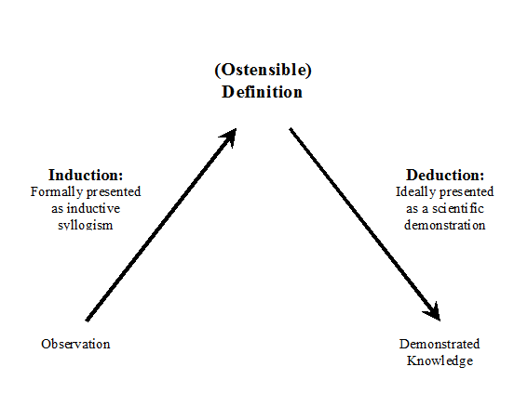
Cause & Effect 原因和影响
places effect before cause
Aristotelian deductive thought
Many English writers will state the conclusion, the topic sentence, or the effect first, and then provide the evidence, the rationale, the cause and other subordinate information.
cause 原因
effect 影响、效果
self-explanatory 自明的、不需加以说明的
beware 注意。当心
be traceable to 可追溯到……
Aristotelian deductive thought 亚里士多德的演绎思维
state 陈述
rationale 基本原理
subordinate 次要的
14

Slide 15

One of the reasons that games like Fortnite are so addicting is that they play on the human emotional system, comprised of a long-standing set of psychological adaptations that has features going back millions of generations and across thousands of kinds of species of animals.
Fortnite 堡垒之夜（网络游戏）
comprised of 由-----------组成
long-standing 长期的
case 论据
evolved 进化
function 机能
motivational 动机
nature 性质
online video game
island
fight
4

Slide 16
Part III: Comparison and Contrast
第2部分：类比
与对比

Slide 17
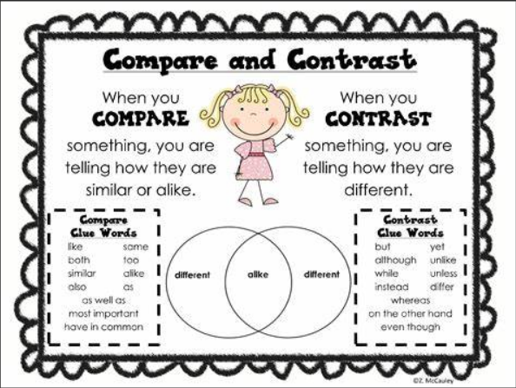
Comparison & contrast 类比和对比
Comparisons and contrast are extensively employed in writing.
such as “in addition”, ”therefore”, ”in contrast”
comparisons and contrast are usually easy to identify through commonly used transitional expressions.
comparison 类比
contrast 对比
extensively 广泛的
hypotactic 主从结构
5

Slide 18
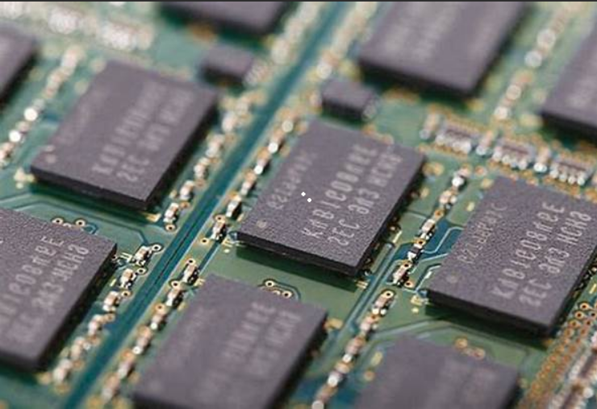
Those details are called central details. In contrast, what we're not paying attention to, or has little or no significance to our brain at the time, are called peripheral detail.
buffer 缓冲存储区
RAM random access memory 随机存储器
from moment to moment 时时刻刻
peripheral 外围
computer science
physical hardware
6

Slide 19
Part IV: Classification
第4部分：分类

Slide 20
Classification
The writer，in order to facilitate reader understanding or arrive at a conclusion, usually needs to define which category a piece of random information belongs to.
标红部分为目的状语插入语

Slide 21
Classification
The principle of classification:
quantitative （定量）
qualitative （定性）
prescriptive （规定性）
descriptive （描述性）
instructive （有启发性的）
argumentative（有争议的）

Slide 22
Classification
Abundant evidence links personality with emotion via coping. Alternatively, personality can be viewed as an emergent property of responses to the experience of emotion. Dispositions to control, approach, escape, and avoid one's emotional experience underlie diverse traits, including positive and negative urgency, trait emotional approach and avoidance, alexithymia, and emotional expressiveness.
情感难言症

Slide 23
Classification
The principle of classification is to focus on the object’s features we study on.
For instance:
The distribution of human.

Slide 24
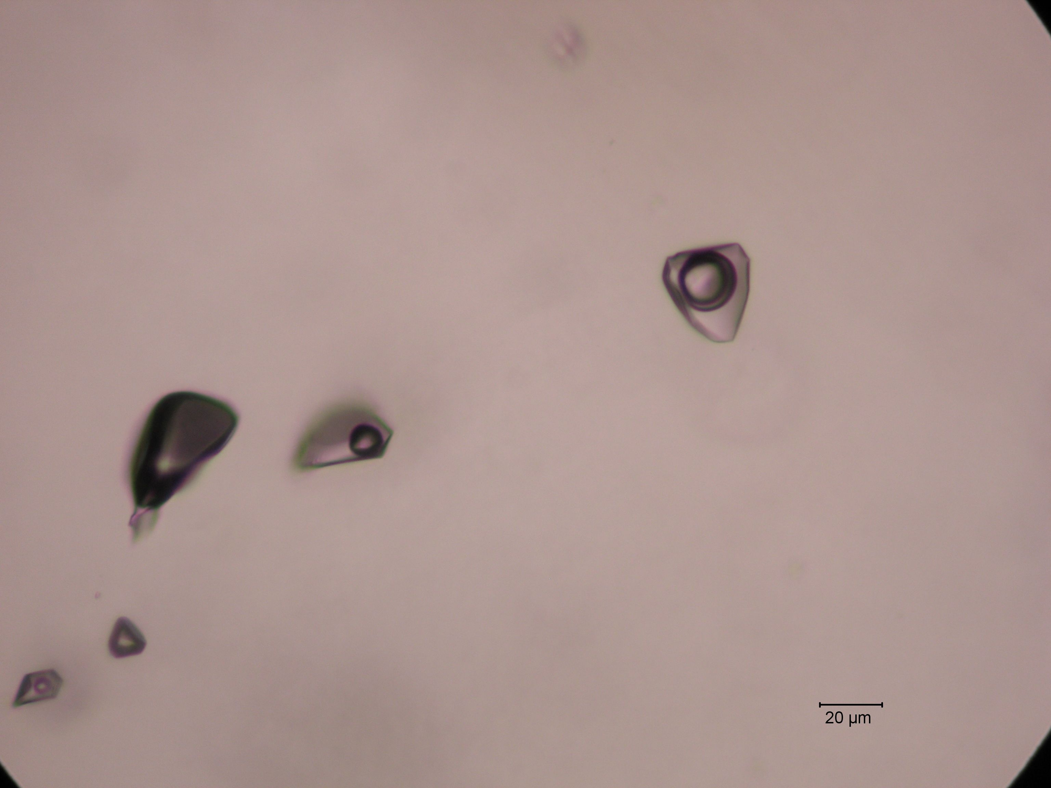
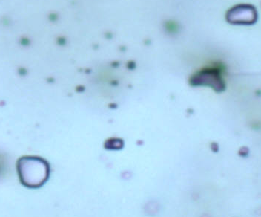
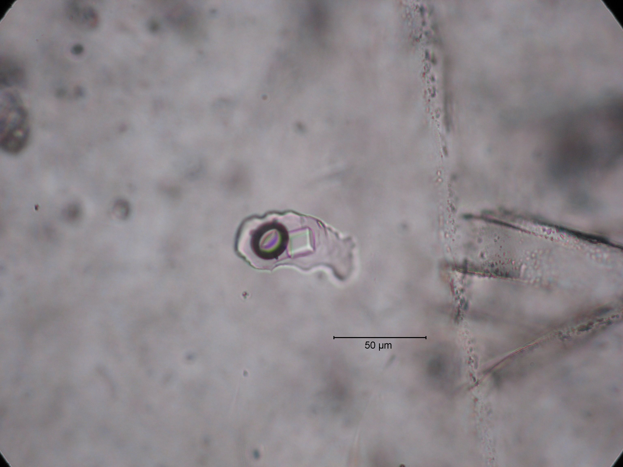
The classification of Fluid inclusions
Phase State: Vapor, Liquid, Solid-bearing

Slide 25
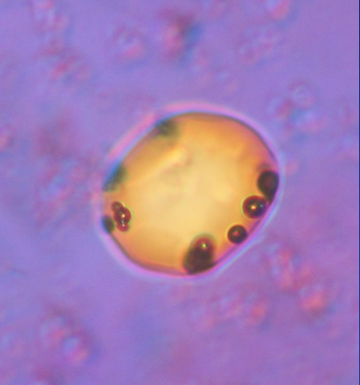
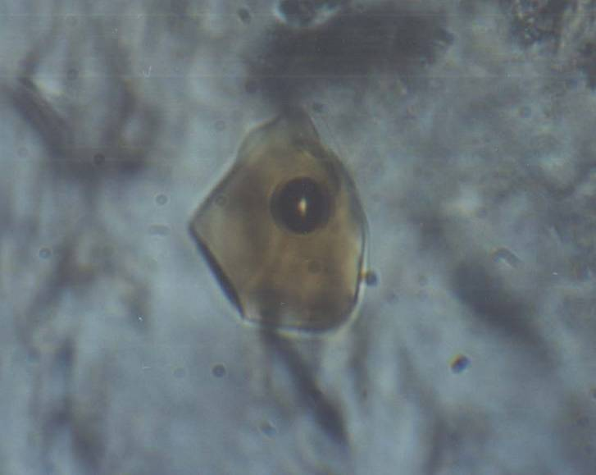
The classification of Fluid inclusions
Composition: Melt, Saline water, Petroleum

Slide 26
Part V: Problem and Solution
第5部分：问题
与解决方案

Slide 27
Relation between problems and solutions
Author
Reader
When we do something…
We find a problem…
Search the keywork in Google…
No Result…
Research and then get some output
Publish your findings with a pattern such as paper on a conference or journal, webpage, etc.
When we read a paper
Remind yourself with what you really need in every waking moment.
Filter 1: Is this a paper what I really need?
If false, then pass.
If true, go to Filter 2.
Filter 2: How to filter out the information I need? (That’s the key ) Focusing on the problem this paper has solved is the key.

Slide 28
You need to extract the Problem first
如果这篇文章的这个段落，真的是按照“问题-解决方案”模式所写，那么必须先提取问题，然后找方案。否则，你将一头雾水，不知道作者在说什么！
特别注意某些词：how, what, why
看一个文章的例子

Slide 29
一个例子
A new study published in computers in Human Behavior shows how attitudes about communicating online – such as whether a person believes texting will lead to miscommunication, is easier than face-to-face communication or is an important part of maintaining relationships – can explain “text intensity”, or how dependent that person is on text messaging. According to Dr. Andrew Ledbetter, there are five attitudes people can hold about online communication. People vary on how much they hold each of these five attitudes. Those variations can come from the way a person grew up communicating with their family or that person’s competence or skill at communicating with others.

Slide 30
一个例子
A new study published in computers in Human Behavior shows how attitudes about communicating online –
such as whether a person believes texting
will lead to miscommunication,
is easier than face-to-face communication or
is an important part of maintaining relationships
– can explain “text intensity”, or how dependent that person is on text messaging. According to Dr. Andrew Ledbetter, there are five attitudes people can hold about online communication. People vary on how much they hold each of these five attitudes. Those variations can come from the way a person grew up communicating with their family or that person’s competence or skill at communicating with others.

Slide 31
一个例子
A new study published in computers in Human Behavior shows how attitudes about communicating online –
such as whether a person believes texting
will lead to miscommunication,
is easier than face-to-face communication or
is an important part of maintaining relationships
– can explain
“text intensity”, or
how dependent that person is on text messaging.
According to Dr. Andrew Ledbetter, there are five attitudes people can hold about online communication. People vary on how much they hold each of these five attitudes. Those variations can come from the way a person grew up communicating with their family or that person’s competence or skill at communicating with others.

Slide 32
一个例子
A new study published in computers in Human Behavior shows how attitudes about communicating online –
such as whether a person believes texting
will lead to miscommunication,
is easier than face-to-face communication or
is an important part of maintaining relationships
– can explain
“text intensity”, or
how dependent that person is on text messaging.
According to Dr. Andrew Ledbetter, there are five attitudes people can hold about online communication. People vary on how much they hold each of these five attitudes. Those variations can come from the way a person grew up communicating with their family or that person’s competence or skill at communicating with others.

Slide 33
Summary
Aim: To get the information we need more efficiently.
How the text is organized? ➔ Framework / Structure
Readers can anticipate what information will be revealed in a selection when they understand text structure.
能自然而言预测文章的段落结构是做好理解的第一步，预测依靠对文章结构的理解
时间顺序、因果关系、问题与解决方案、对比……及其组合（一定要在阅读的时候，问自己：这个段落是什么结构？）
That’s all, Thank you.

